Slide 1
Azure Devops
Custom Tasks

Slide 2
Video Overview
Pre-requisites/Dependencies to get started
Folder/Directory structure
Task creation
Package Task
Publish Task
Make Task revisions

Slide 3
Pre-requisites and Dependencies
Azure Devops Organization
NodeJS (version 10.x or higher)
Typescript Compiler (version 2.2.0 or higher)
Cross-Platform CLI for Azure DevOps aka tfx-cli

Slide 4

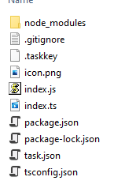
Folder/Directory structure
README.md
Images
Extension-icon.png
buildAndReleaseTask
(All files that define Task)
vss-extension.json

Slide 5
Task Creation
Task Scaffolding – Pre-reqs and setup for task creation
Create Task
Package Task
Publish Task
Sharing Task with Organizations

